Slide 1
High School Parent Advisement

Slide 2
Note to Schools :
This PowerPoint can be added to, but you cannot take away information from this presentation. There are important topics that we need to make sure parents and students know about. It is crucial that the information provided is covered with fidelity.
- Dr. Daws

Slide 3
Graduation Requirements
The Paulding County School District follows the state guidelines for graduation.
No additional requirements have been added to what is set out in the IHF(6) policy from the Georgia Department of Education.
Requires:
  4 Credits of English, Math, Science
  3 Credits of Social Studies
  3 Credits of CTAE, World Language, or Fine Arts (Some combination)
  1 Credit of Health & Personal Fitness
  4 Credits of Electives
  23 Total Units of Credit.

Slide 4
Earning a High School Diploma
In Georgia, students must earn 23 specific credits to earn their high school diploma.
Each block course is worth 1 credit.
A student must earn a 70 or above to pass their classes.
If a student fails a course required for graduation, they will have to repeat the course to earn the credit.

Slide 5
English (ELA) Requirements
Required:4 Total Units of Credit for English.
  1 Full Credit of Literature & Composition I
  1 Full Credit of Literature & Composition II
  2 Additional Core Credits of English.
Most Common Sequence:
Grade | Beginning in 25-26
9th | Literature & Comp. I
10th | Literature & Comp. II
11th | American Literature
12th | Any Core English

Slide 6
Math Requirements
Required:4 Total Units of Credit for Math.
  1 Full Credit of Algebra Concepts & Connections
  1 Full Credit of Geometry Concepts & Connections
  1 Full Credit of Advanced Algebra Concepts & Connections
  1 Additional Core Math Credit
Math must be taken in sequence!
Most Common Sequence:
Grade | Class
9th | Algebra Concepts & Connections
10th | Geometry Concepts & Connections
11th | Advanced Algebra Concepts & Connections
12th | Pre-Calculus, Stat. Reasoning, or Advanced Math Decision Making

Slide 7
Science Requirements
Required:4 Total Units of Credit for Science.
  1 Full Credit of Biology
  1 Full Credit of Physical Science OR Physics
  1 Full Credit of Chemistry, Earth Systems, or Environmental Science
  1 Additional Core Science Credit
Most Common Sequence:
Grade | Class
9th | Biology
10th | Chemistry
11th | Physics I
12th | 4th Sciences Vary

Slide 8
Social Studies Requirements
Required: 3 Total Units of Credit for Social Studies.
  1 Full Credit of World History
  1 Full Credit of U.S. History
  ½ Credit of American Government
  ½ Credit of Personal Finance and Economics
Most Common Sequence:
Grade | Class
9th | World Geography (e)
10th | World History
11th | U.S. History
12th | Government/Economics
Note: While World Geography counts as an elective towards Graduation, it does count as a core class for the HOPE Scholarship.

Slide 9
Additional Graduation Requirements
3 Credits of World Language, CTAE, or Fine Arts
1 Credit of Health and Personal Fitness
4 Credits of Electives
2 World Language Credits (in the same language) are not required to Graduate, but it is a requirement to get into a 4-year college.

Slide 10
Fine Arts Courses
If Band, Chorus, Drama, and/or Visual Arts are courses that you enjoy, these courses can count as “Fine Arts” credit or as regular elective credit. Three courses will complete a Fine Arts Pathway.
Once a student has earned the three units required for CTAE/World Language/Fine Arts, the remaining courses will count toward the required Elective credits.
Slide 22

Slide 11
Advanced Course Offerings
Honors
Introduction to Advanced Classes
+5 Points on Transcript
Advanced Placement
Preferred by Larger Schools for College Enrollment (GT/UGA)
+10 Points on Transcript
Dual Enrollment
College & HS Credit Simultaneously
30 Free Credit Hours starting Junior Year
10+ Points

Slide 12
Grade Level Promotion
Promotion depends on the number of credits!
10th Grade: 5.0 Credits
11th Grade: 11.0 Credits
12th Grade: 17.0 Credits

Slide 13

Sports Eligibility
All first-time 9th Grade Students are Eligible in the Fall.
Eligibility Depends On:
  Active Physical Exam (Good for 12 Months)
  Passing 2.5 Credits in the Previous Semester.
  Being “On-Track” for Graduation
    This means having at least:
      5 Credits as a 10th Grader
      11 Credits as a 11th Grader
      17 Credits as a 12th Grader
  Discipline: ISS/OSS= No Practice/Games
  Eligibility is determined by the GHSA and the above are just the most common requirements. Full requirements can be found at www.ghsa.net .

Slide 14

NCAA Guidelines for
Potential College Athletes
NCAA Eligibility Center: https://web3.ncaa.org/ecwr3/
There are different academic requirements for Division I, II, and III.
Minimum GPA’s must be met and course completion requirements exist.
  Talk to your School Counselor if playing College Sports is something you are interested in.

Slide 15

HOPE SCHOLARSHIP
Started in 1993, Merit Based Scholarship for Georgia Graduates
Requirements focus mainly on residency and academic performance.
The money goes towards college tuition only.
Full requirements and details can be found at www.gafutures.org
GSFC
HOPE Scholarship
Zell Miller Scholarship

Slide 16
HOPE Scholarship Requirements
Enroll in a degree-seeking USG, TCSG, or eligible private college/university.
Must be a state resident for 12 consecutive months prior to the first day the term.
HOPE Scholarship: Must have at least a 3.0 HOPE GPA .
Zell Miller Scholarship: Must have at least a 3.7 HOPE GPA plus:
- a minimum composite score of 25 on the ACT or
- a minimum score of 1200 on the SAT.
Must have at least 4 Rigorous Courses on the Transcript
  Rigorous Course List is Found at www.gafutures.org

Slide 17
HOPE GPA
Classes Included in HOPE GPA
Classes NOT in HOPE GPA
English
Science
Math
Social Studies
World Language
CTAE
P.E.
Non-Core Electives
Fine Arts
Any High School Course Taken in Middle School.

Slide 18
Example of Traditional GPA vs. HOPE GPA
Traditional GPA
HOPE GPA
Advanced Algebra – B (3 pts.)
U.S. History- C (2 pts)
Intro to Team Sports- A (4 pts.)
Intro to Digital Tech- B (3 pts)
(3+2+4+3)/4= 3.0 GPA
Advanced Algebra – B (3 pts.)
U.S. History- C (2 pts)
Intro to Team Sports- A (0 pts)
Intro to Digital Tech- B (0 pts)
(3+2)/2= 2.5 GPA

Slide 19

What is Dual Enrollment?
Dual Enrollment (DE) is a program where Georgia students enrolled in grades 10-12 can earn high school course credits while taking college courses.
DE is available for all 11th and 12th grade students and some 10th grade students meeting certain criteria.
  10th Grade students can take all CTAE classes at Technical Schools.
  10th Grade students meeting Zell Miller Requirements (1200 SAT or 25 ACT/3.7 GPA) can take core classes.
Student can take up to 30 hours of college courses for Free!

Slide 20
Dual Enrollment
FINANCIAL BENEFITS OF DUAL ENROLLMENT:
  The average Georgia student pays $794 per credit hour for college tuition, room, and board to a 4-Year University. If a student takes the maximum of 30 credit hours through Dual Enrollment, it’s a savings of $23,820.
  In 2024-2025, PCSD Students saved a total of $6.18 Million Dollars by taking 2,593 Dual Enrollment courses.
ADDITIONAL BENEFITS FOR STUDENTS:
  College Readiness: Helps students adjust to college expectations and build perseverance.
  Transferability of Credits: Dual Enrollment credits can apply to future degrees.
  Degree Completion: Students who participate in dual enrollment are more likely to enroll in and complete a college degree.
  Flexibility : Provide students with options to shape their higher education path.

Slide 21
Things to consider with being a Dual Enrollment Student….
Maturity level of the student
Post-secondary plans of the student
Individual career goals and IGP (Individual Graduation Plan)
Necessary tests for admission to the postsecondary institution(s) of choice
Application and acceptance by the post-secondary institution

Slide 22
Dual Enrollment
Your High School Counselor is the best person to contact if you have questions regarding Dual Enrollment.
Additional Information can be found:
PCSD School Website
GA Futures Website
School Counselors Website

Slide 23

www.GAfutures.org
GAfutures (MyGAfutures Account)
  MyGAfutures GPA HOPE information
  College Applications in Georgia
  Scholarships
  FAFSA and Financial Aid
  Financial Literacy
  Dual Enrollment Application
  to Georgia Student Finance
  Commission

Slide 24

Work-Based Learning
A student may be eligible to participate in one of the Work-Based Learning Programs.
  Opportunities include:
    Youth Apprenticeship
    Cooperative Education
    Internship
    Employability Skills Development
Benefits:
  Start your career while you are in high school
  Develop employability and technical skills to be successful
  Network and make connections in your chosen industry
Interested students should contact the school counselor or WBL Coordinator for additional information.
Slide 37

Slide 25

What if I wanted to take a course Online during high school?
During the months of April – Mid-July, there will be a PCSD online registration opportunity for high school courses.
Senate Bill 289 allows Georgia districts to provide students in grades 3 through 12 the option of taking an online course should you choose that option.

Slide 26




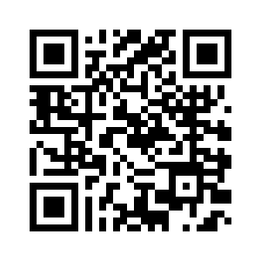



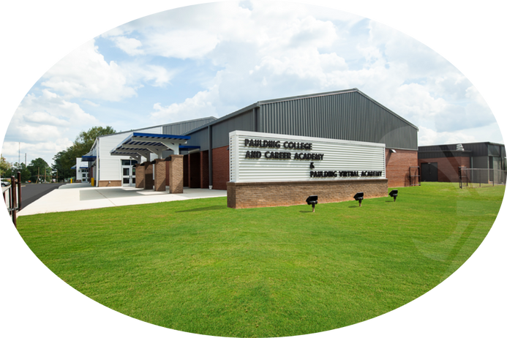
NEW
DISCOVER
OPPORTUNITIES
@
Paulding Virtual Academy
PVA offers a 100% virtual online high school to any PCSD high school student interested. We offer all courses required by the State of Georgia for graduation as well as many electives not offered in traditional face-to-face schools. For a complete list of courses offered visit our website at https://www.paulding.k12.ga.us/Page/75 or scan the QR code.
At New Hope Education Center, PVA also partners with the Paulding College and Career Academy and Chattahoochee Technical College for opportunities to:
  complete various Career Pathways
  earn both high school and college credits by taking Dual Enrollment courses
  earn certificates for jobs in high-demand industries.
For more information & questions, please email:
pauldingvirtual@paulding.k12.ga.us

Slide 27


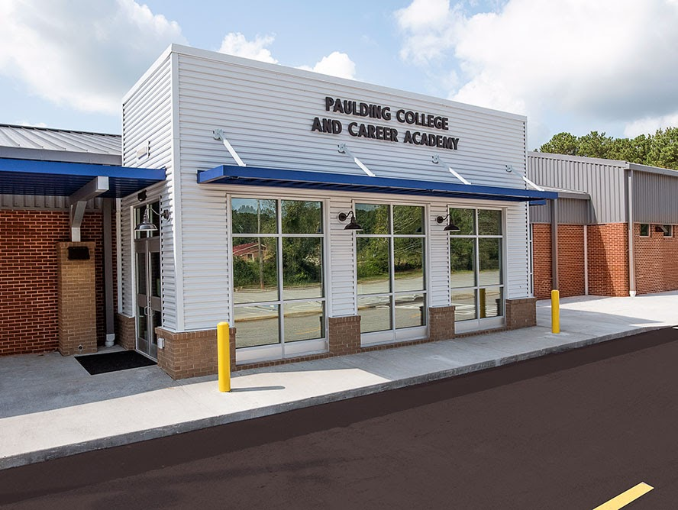
Paulding College & Career Academy
When do I come to class?
Students attend either an AM or PM session on our campus.
How do I get to PCCA?
Bus transportation is provided to PCCA from the home high schools each day for both sessions. Students are also allowed to drive to PCCA (with the purchase of a $10 per year parking pass)
How many classes do I take during my PCCA session?
Students will take two classes, but there are many combinations of classes that students can take. These can include: PCCA Pathway courses, PCCA Dual Enrollment courses, Work-Based Learning, online courses, and minimum day (Seniors only).

Slide 28

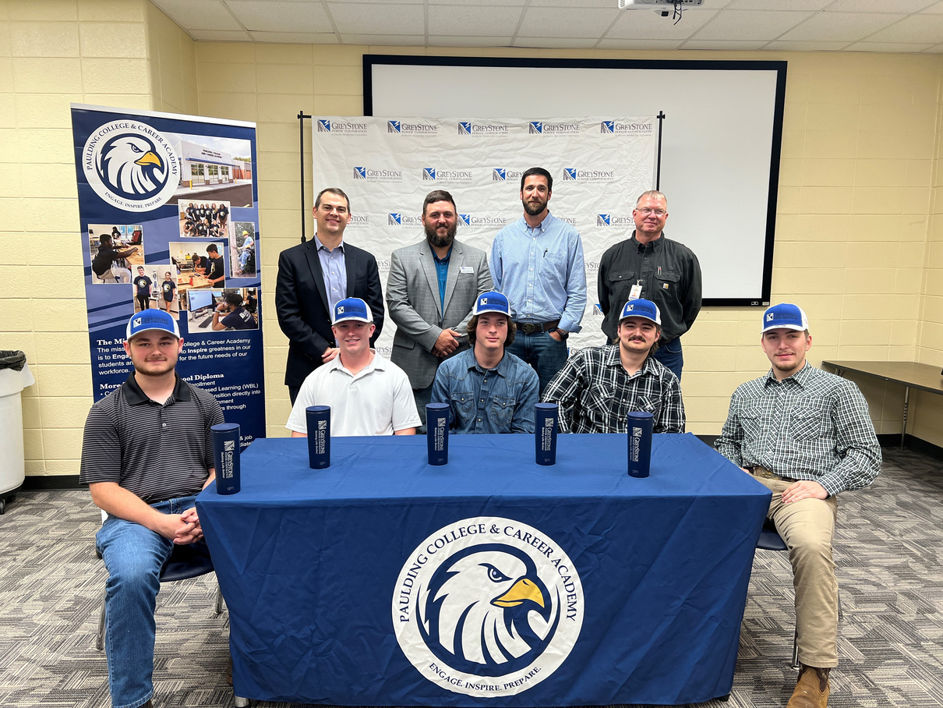
PCCA Pathways
Mechatronics -
(Engineering/Robotics/Aviation)
Cybersecurity
Energy - Lineman
Healthcare
  Certified Nursing Assistant
  Certified Medical Assistant
  Patient Care Tech

Slide 29



Student Opportunities
at PCCA
Work-Based Learning/Apprenticeships
Technical Certificates
to help build your resume and help get a job after graduation
Dual Enrollment Credits
that lead to jobs with our business and industry partners
that you can take to college

Slide 30
Academic Testing in High School
End of Course Tests
Literature & Composition II
Biology
U.S. History
Algebra Concepts & Connections
PSAT
Preliminary Scholastic Aptitude Test
Provides a standardized view of a student’s scholastic skills and helps students compare themselves with other college-bound students nationwide.
Taken in October of 10th Grade Year.
SAT / ACT
Standardized tests that colleges use to evaluate applicants

Slide 31

School Counselors
Promote development and support for EVERY student in the three Domains:
  Academic
  Career
  Personal/social

Slide 32

Academic & Career Advisement
Required Academic & Career Advisement in Georgia (BRIDGE Bill):
  4- Year Graduation Plan
  Aptitude & Interest Inventory given to students (You Science)
  Exploring High-Demand Careers
Multi-Year Academic Planner (MYAP)
  In Infinite Campus, you can see your child’s 4-year Graduation Plan.
  This is used to help schedule classes for each school year.

Slide 33
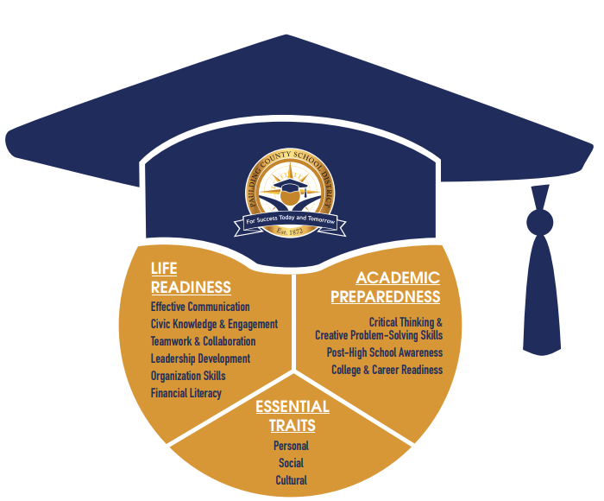
The Graduate Profile
The list of skills and competencies that students should have when they graduate.

Slide 34
Embedded Credits
Some high schools offer courses that have “Embedded Credits”. This is where a student will take a course and if they pass the course, then the student will be awarded two credits for taking the one course.
Two Examples:
  Essentials of Healthcare has an embedded credit of Human Anatomy and Physiology.
  Dramatic Writing has an embedded credit of Advanced Composition.
Both courses can count for HOPE
There are many options for Embedded Credits through CTAE courses.

Slide 35
Being a Pathway Completer
All students are strongly encouraged to select a Plan of Study/Pathway and complete a sequence of 3 courses in one of the following areas:
  CTAE
  Advanced Academics
  Fine Arts
  World Language

Slide 36
Fine Arts Courses
If Band, Chorus, Drama, and/or Visual Arts are courses that you enjoy, these courses can count as “Fine Arts” credit or as regular elective credit. Three courses will complete a Fine Arts Pathway.
Once a student has earned the three units required for CTAE/World Language/Fine Arts, the remaining courses will count toward the required Elective credits.
Slide 22

Slide 37
PSAT
The Preliminary Scholastic Aptitude test provides a standardized view of a student’s scholastic skills, regardless of the school attended, and helps students compare themselves with other college-bound students nationwide.
This test is taken in October of your 10th grade year during the school day.

Slide 38
ACT and SAT
SAT:
A test designed to assess academic reainess for college.
The SAT tests the reading, writing, and math skills you have learned.
Register through College Board! (www.collegeboard.org)
ACT:
This is considered a type of college entrance exam.
Multiple-Choice test that covers English, Math, Reading, and Science.
The Writing Test, which is optional, measures your skills in planning and writing a short essay.
Register through www.act.org

Slide 39
Diploma Seals
Students can earn “Seals” on their Diplomas for taking groups of classes in a certain area:
State Diploma Seals:
  Civic Engagement, Fine Arts, International Skills, Seal of Biliteracy
County Diploma Seals:
  The Paulding County School District recognizes students that complete Advanced Academic Pathways as described by the GADOE by giving students diploma Seals.
  These seals can be earned in all four core content areas, World Language, Journalism, and Fine arts.
  Requires 4 units of credits in most areas, with one AP or DE credit, and 2 World Language Credits.

Slide 40
All Students Should:
Focus on academics
Take rigorous/relevant courses
Keep organized
Research!
  Use GAfutures.org and the Georgia Career Information System,
  Continue career exploration and use Youscience results.
  Consider Dual Enrollment or Work-based Learning
  Look for scholarship information
  Begin to explore application process, if you will be attending a post-secondary institution
Please keep HOPE Alive!!!!!

Slide 41

Questions?

